Slide 1
Natural Language Processing
Josh Bernhard
University of Colorado - Denver

Slide 2
Natural Language Processing (NLP)
The goal of natural language processing is to ‘enable computers to derive meaning from human or natural language input.’
A large part of natural language processing is sentiment analysis.
Sentiment analysis is about determining the attitude of human language.
Natural language processing and sentiment analysis are used by companies to better understand company image using comments provided on facebook, twitter, yelp, linkedin, etc.

Slide 3
Sentiment Analysis
Commonly we are interested in identifying a comment as:
Positive
Neutral
Negative
Once a comment is identified as positive, neutral, or negative; we often provide an associated score:
Positive = 1
Neutral = 0
Negative = -1
Then we could identify common issues among the -1 comments
We might compare companies by averaging the scores for each company.
You could also use traditional 5, 7 or 10 point scales.

Slide 4
Sentiment Analysis Examples
The process of NLP is not always easy.
Ex:
The food was great, the service was awesome, and we had a wonderful time.
Our service was excellent, but the food was eh.
The atmosphere was not great. There drinks were cheap, and we made the most of it.
The service was good, but our food was cold.
The food was good, but it took forever for us to be waited on.
The atmosphere was great! We had a great time, and the drinks were cheap!

Slide 5
Latent Semantic Analysis
Another common NLP technique is known as Latent Semantic Analysis.
Latent semantic analysis is a technique used to identify common topics of multiple documents.
Alternatively, latent semantic analysis might identify if documents are discussing the same topic.
Latent semantic analysis provides the topics/ideas of a text. It does not count individual words like other NLP techniques.
Singular value decomposition is used as the mathematical method to identify the similarities. SVD is a technique that is often used similar to PCA. It reduces the dimensionality of a matrix, which is important when looking at multiple documents or multiple text entries.

Slide 6
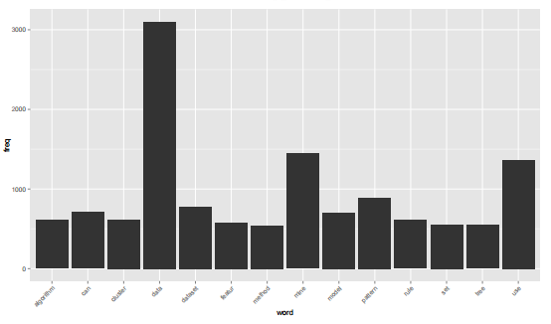
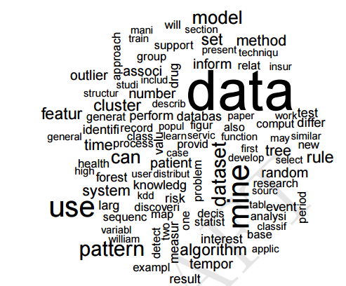
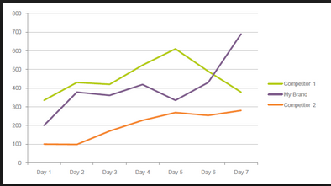
Common Visual Methods for Text
Bar charts
Word Clouds
Time Plots

Slide 7
NLP Notes
We generally remove articles (the, an, a, etc.) when performing any type of NLP.
These terms are not important for the purpose of most (if any) sentiment analysis.
Often NLP is combined with Text Mining (TM). Text mining is often defined as a way of looking through text. Then NLP is a way to pull certain aspects from the text (sentiment or latent semantics).
Onook teaches a full class on this topic using SAS Enterprise Minor.
There are multiple R Packages that will assist with NLP and TM.

Slide 8
Additional Resources
http://cran.r-project.org/web/views/NaturalLanguageProcessing.html
http://www.kdd.org/sites/default/files/issues/7-1-2005-06/1-Intro.pdf
http://onepager.togaware.com/TextMiningO.pdf
https://www.youtube.com/watch?v=-2Koi-caSZw
https://www.youtube.com/watch?v=j1V2McKbkLo
https://www.coursera.org/course/nlp

